Slide 1
Day 4 - Networks
UMN CSS Workshop 2025
Instructor: Alvin Zhou

Slide 2
Group
Group 1
Gretchen Corcoran
Jikai Sun
Shreepriya Dogra
Jialu Fan
Group 2
Jiacheng Huang
Paulina Vergara Buitrago
Jong Won Lee
Eun Sun Kyoung
Group 3
Sijin Chen
Michael Ofori
Jinny Zhang
Dongwook Kim
Group 4
Raj Wahlquist
Nicole Marie Klevanskaya
Wenhui Cheng
Rita Rongwei Tang
Mixed background and coding skills
Group members who are confident in their coding skills, please help other members during the afternoon coding labs

Slide 3
Learning Goals
Understand the logic of networks and network analysis
Learn basic network concepts (node, edge, centrality, closure)
Explore ways networks are used in social science research
Distinguish descriptive, predictive, and inferential use of networks
Review case studies applying network science across disciplines

Slide 4
What is a Network?
A network is a collection of nodes (entities, also called vertices) and edges (relationships, also called ties)
Node: Entity (e.g., person, organization, word)
Edge: Relationship between nodes (e.g., friendship, citation)
Edges can be directed vs. undirected, and weighted (stronger ties = higher weight)
Graph: set of nodes + edges
Common examples:
Social networks: people connected by friendship
Citation networks: papers citing each other
Semantic networks: words co-occurring in texts

Slide 5
Adjectives for Networks
Property Type | Description | Example
Directed / Undirected | Are edges one-way or two-way? | Twitter (directed), Facebook (undirected)
Weighted / Unweighted | Do edges have strength/weight? | # of emails sent between people
Static / Dynamic | Does the network change over time? | Temporal networks of contact tracing
Bipartite (Two-mode) | Are there two types of nodes, and edges only run between types? | Users and events, students and classes
Multiplex | Are there multiple types of relationships between nodes? | Friends + coworkers
Signed | Do edges carry positive/negative valence? | Trust/distrust networks
Sparse / Dense | How many edges exist relative to possible? | Most real networks are sparse; thus, we sometimes use network “components” (i.e., maximally connected subgraph)

Slide 6
Network Measures – Centrality
Degree centrality: # of ties
Betweenness centrality: How much a node bridges other nodes
Closeness centrality: how close a node is to others
Eigenvector centrality: influence via influential neighbors
Measured per Node

Slide 7
Centrality in Directed or Weighted Networks
Directed Graphs:
In-degree centrality: # of incoming ties (e.g., followers on Twitter)
Out-degree centrality: # of outgoing ties (e.g., following on Twitter)
Betweenness and Closeness may yield asymmetric values depending on directionality.
Weighted Graphs:
Centralities account for tie strength
Example: A node with 2 weak ties (weighted 1 each) is not equal to one with a strong tie (weighted 5).
Use weighted degree (we usually call “weighted degree” as “strength”), weighted betweenness, etc.

Slide 8
Network Measures – Other Measures
Local clustering coefficient: Likelihood that a node’s neighbors are also connected.
Constraint (Burt’s constraint): How redundant a node’s contacts are; lower values suggest brokerage potential.
Brokerage (Gould-Fernandez Brokerage): Nodes that connect otherwise disconnected communities; you can also calculate scores for different brokerage roles
K-core: The maximal subgraph in which every node has at least degree K
PageRank Centrality: A variant of eigenvector centrality, used by Google’s search algorithm.
Measured per Node
Structural holes: not a per-node measure, but refers to gaps in the network where two alters are not connected; brokers who span these gaps may hold strategic advantage.

Slide 9
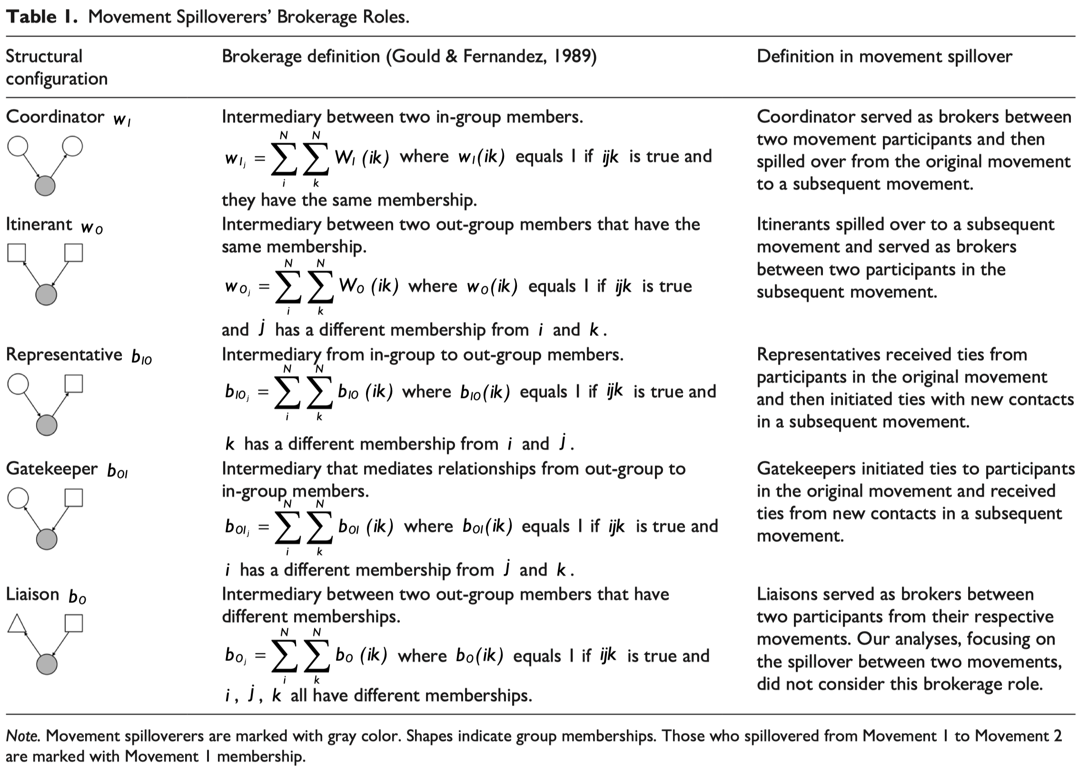
Network Measures – Other Measures

Slide 10
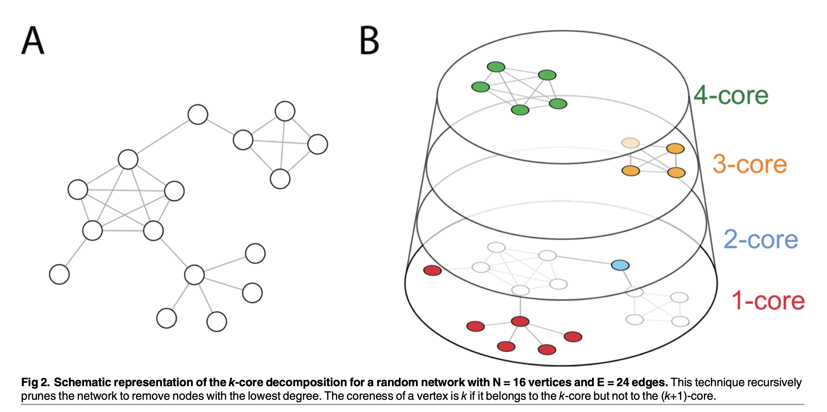
Network Measures – Other Measures

Slide 11
Network Measures – Calculation
A—B—C
| |
D E
Calculate the degree for all nodes.
Who has the highest betweenness and closeness?
Open R script <Network_Demo_1.R> and run it ☺

Slide 12
Network Measures – Calculation
A—B—C
| |
D E
Calculate the degree for all nodes.
Who has the highest betweenness and closeness?
Now, imagine the edges are weighted: A–B = 5, others being 1. How does that change the measures and your intuition?
Open R script <Network_Demo_2.R> and run it ☺

Slide 13
Network Measures – Measured per Graph
Density
Average path length
Transitivity (a.k.a. clustering coefficient)
There are many types of transitivity
What we calculated per node earlier is called “local transitivity / local clustering coefficient.”
We can also measure the clustering coefficient for the whole graph
Modularity (community strength)
Open R script <Network_Demo_3.R> with mock human friendship data and run it ☺
The script also contains other measures and visualization code

Slide 14
Presentation: Schlosser et al. (2020)

Slide 15
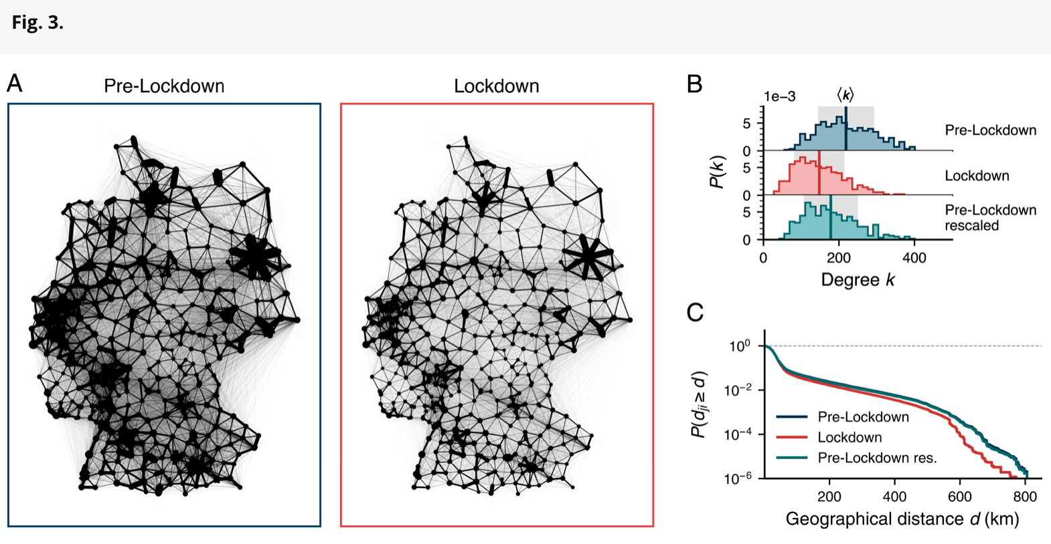
Presentation: Schlosser et al. (2020)

Slide 16
How to use networks in SoSci research
Descriptive use
Semantic networks
Network visualization
Predictive use (network as IVs)
Centrality/brokerage/… serve as IVs in regressions
Inferential modeling (network as DV)
ERGM and its variants
Network simulation and other generative network models
Networks as embedded structures for inquiry
Network experiment

Slide 17
How to use networks in SoSci research
Descriptive use
Semantic networks
Network visualization
Predictive use (network as IVs)
Centrality/brokerage/… serve as IVs in regressions
Inferential modeling (network as DV)
ERGM and its variants
Network simulation and other generative network models
Networks as embedded structures for inquiry
Network experiment

Slide 18
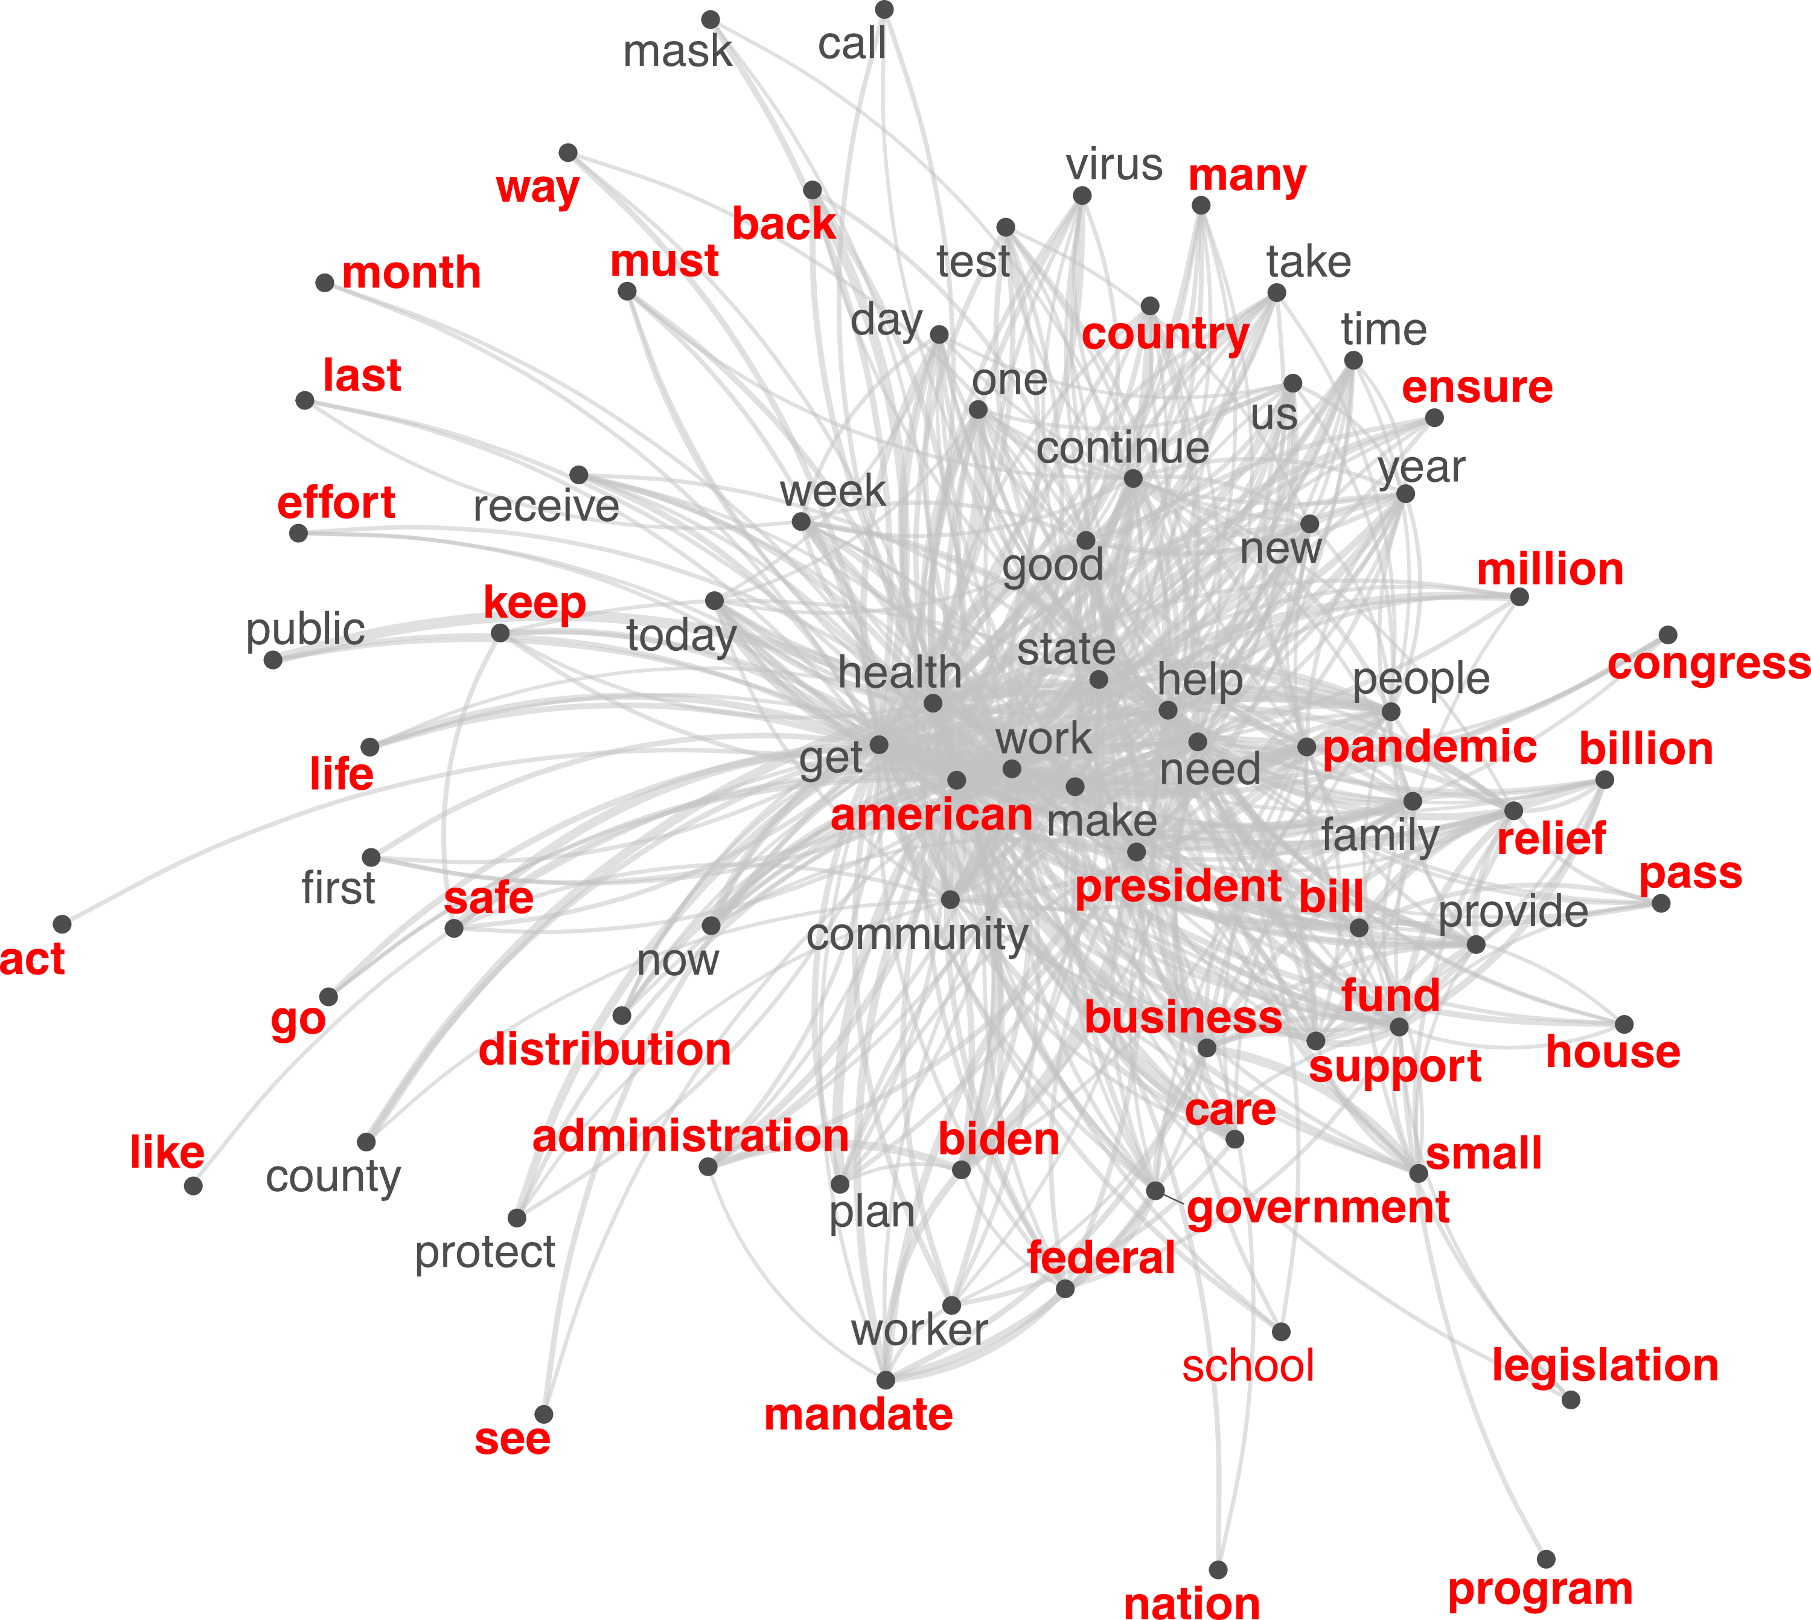
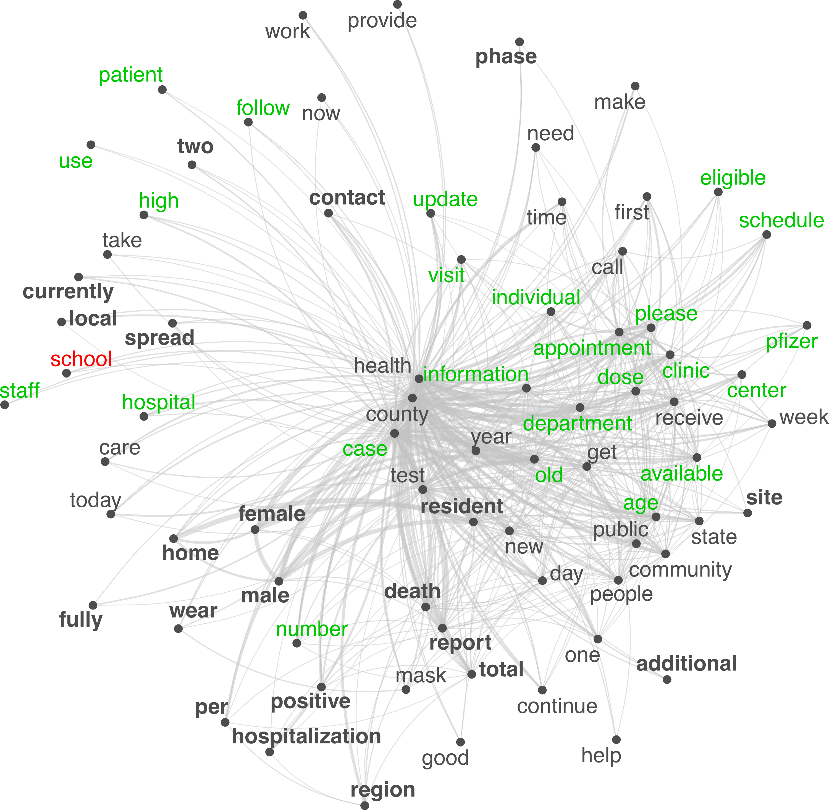
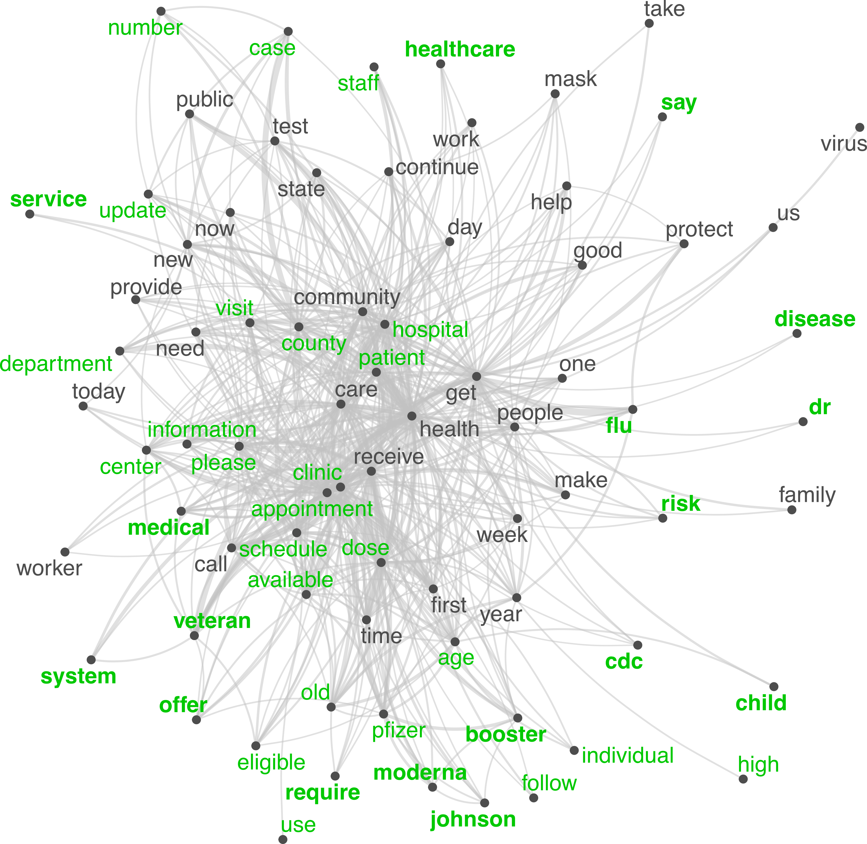
Semantic Networks
Words/terms as nodes
Co-appearance as ties – (could be) weighted, undirected
Easily represent textual information

Slide 19
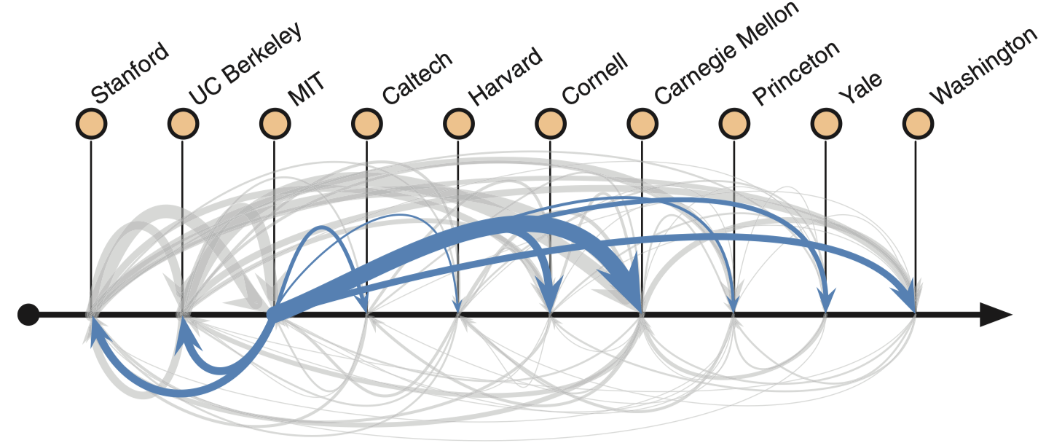
Network Visualization
Convey arguments on networking phenomena.
Hiring networks among prestigious CS PhD programs.
Clauset, A., Arbesman, S., & Larremore, D. B. (2015). Systematic inequality and hierarchy in faculty hiring networks. Science Advances, 1(1), e1400005.

Slide 20
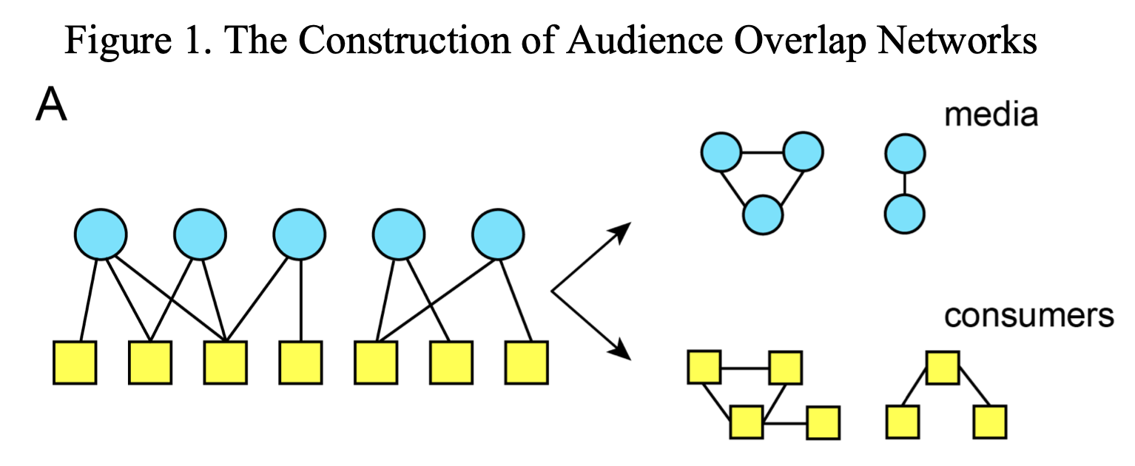
Network Visualization
Convey arguments on networking phenomena.
Dual-projection networks.
Mukerjee, S., Majó-Vázquez, S., & González-Bailón, S. (2018). Networks of audience overlap in the consumption of digital news. Journal of Communication, 68(1), 26–50.

Slide 21
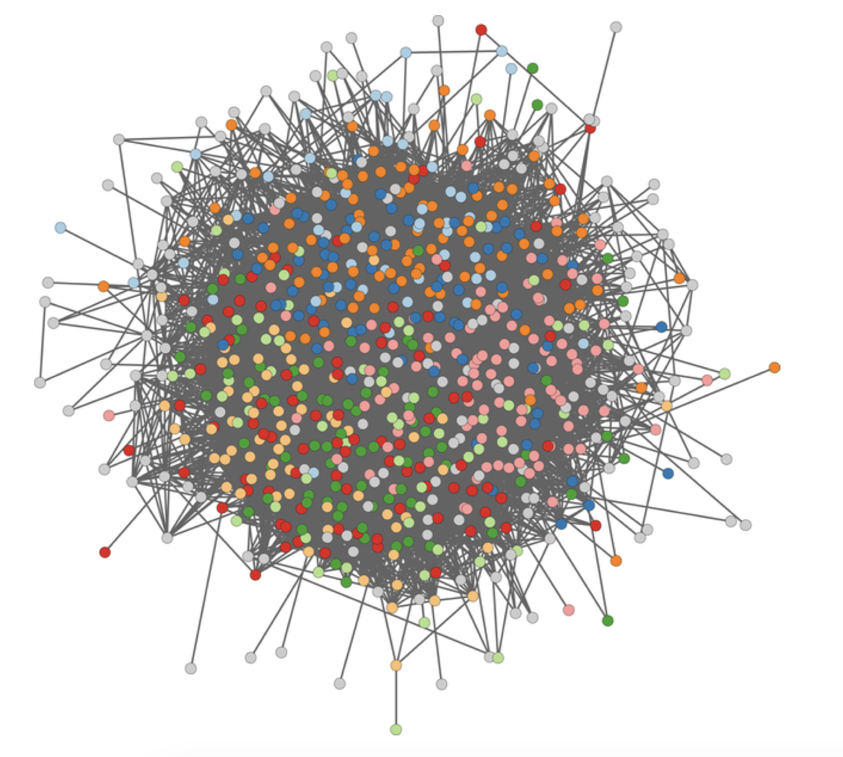
Network Visualization

Slide 22
Network Visualization
Convey arguments on networking phenomena.
Avoid hairball visualizations that convey little information.
Venturini, T., Jacomy, M., & Jensen, P. (2021). What do we see when we look at networks: Visual network analysis, relational ambiguity, and force-directed layouts. Big Data & Society, 8(1), 205395172110184.
Nocaj, A., Ortmann, M., & Brandes, U. (2015). Untangling the hairballs of multi-centered, small-world online social media networks. Journal of Graph Algorithms and Applications, 19(2), 595–618.
Use filtering techniques (e.g., backbone extraction) / color / size / force-directed layouts, etc

Slide 23
Presentation: Vosoughi et al. (2018)

Slide 24
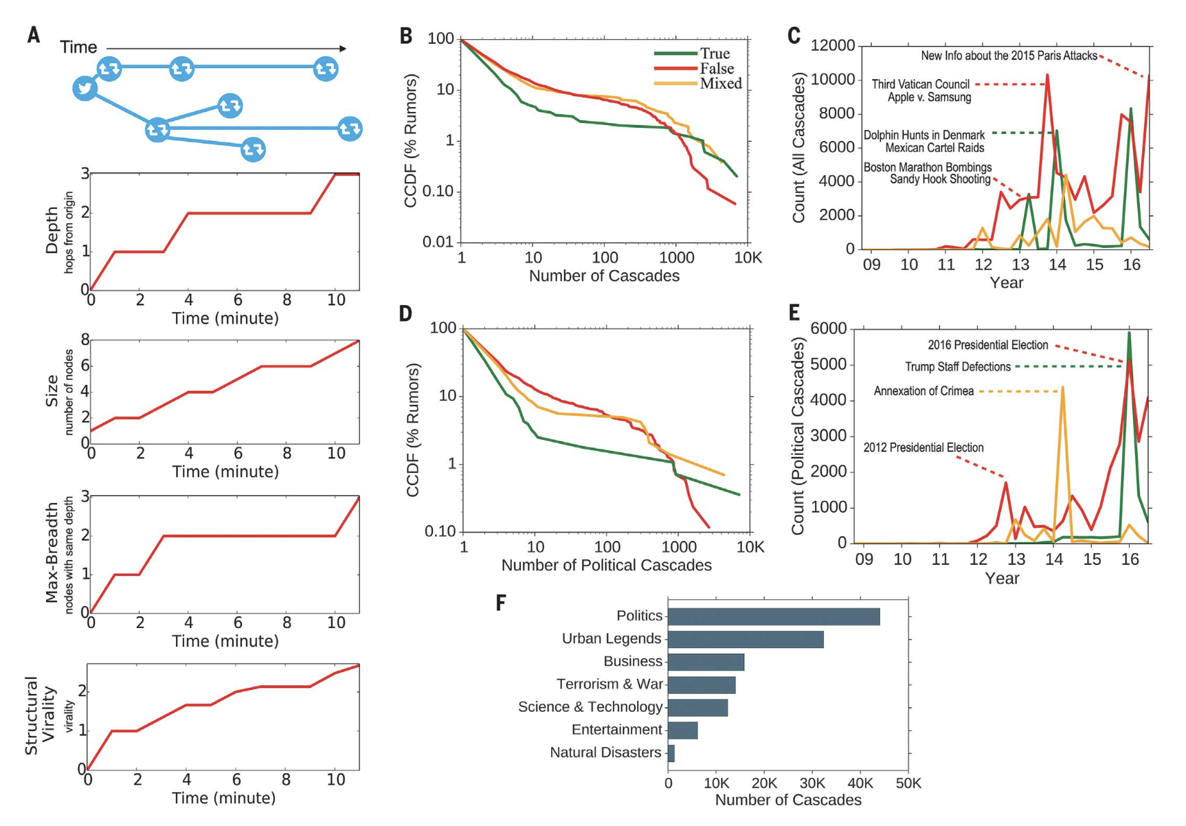
Presentation: Vosoughi et al. (2018)

Slide 25
How to use networks in SoSci research
Descriptive use
Semantic networks
Network visualization
Predictive use (network as IVs)
Centrality/brokerage/… serve as IVs in regressions
Inferential modeling (network as DV)
ERGM and its variants
Network simulation and other generative network models
Networks as embedded structures for inquiry
Network experiment

Slide 26
Network measures as variables
Network position predicts / associates with future outcomes.
Centrality, brokerage, and other network-based metrics act as IVs in regression, panel models, or other methods.
You can also compare groups’ network measures to tell a story

Slide 27
Network measures as variables
Yang, A., & Saffer, A. J. (2021). Standing out in a networked communication context: Toward a network contingency model of public attention. New Media & Society, 23(10), 2902–2925.
Context: Public attention to organizations during protests.
Network IVs:
Network constraint (Burt): Measures redundancy of connections (low = brokerage).
Centrality Measures
DV: Volume of public engagement.
Method: Regression Trees – How IVs help predict DV
Finding: Less constrained (i.e., more broker-like) accounts received more attention.

Slide 28
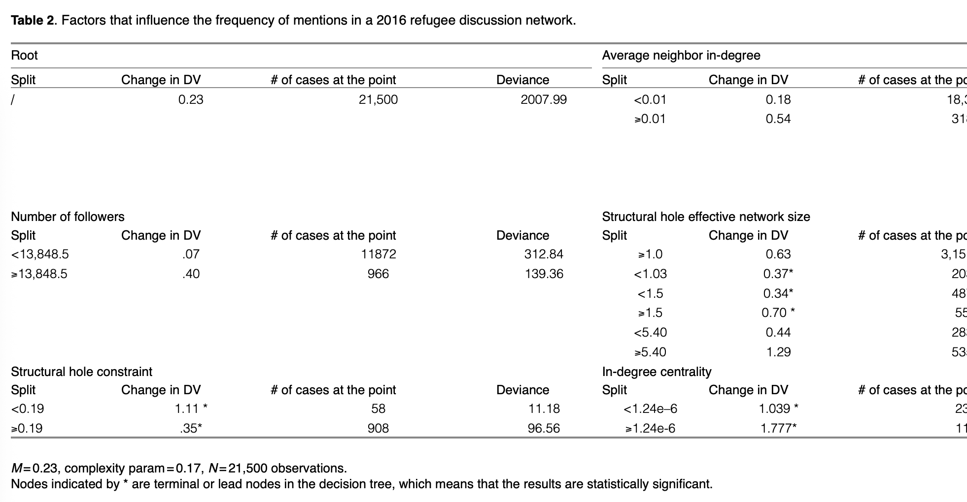
Network measures as variables

Slide 29
Network measures as variables
Larson, J. M., Nagler, J., Ronen, J., & Tucker, J. A. (2019). Social networks and protest participation: Evidence from 130 million Twitter users. American Journal of Political Science, 63(3), 690–705.
Context: Protest participation during political events on Twitter.
Pair Comparison:
Participants: Those who were confirmed in attendance at the protest
Potential Participants: Those who could have participated but did not
DV: Network measures (e.g., ego-network density; tie strength)
Finding: Users central to protest communities were more likely to participate.

Slide 30
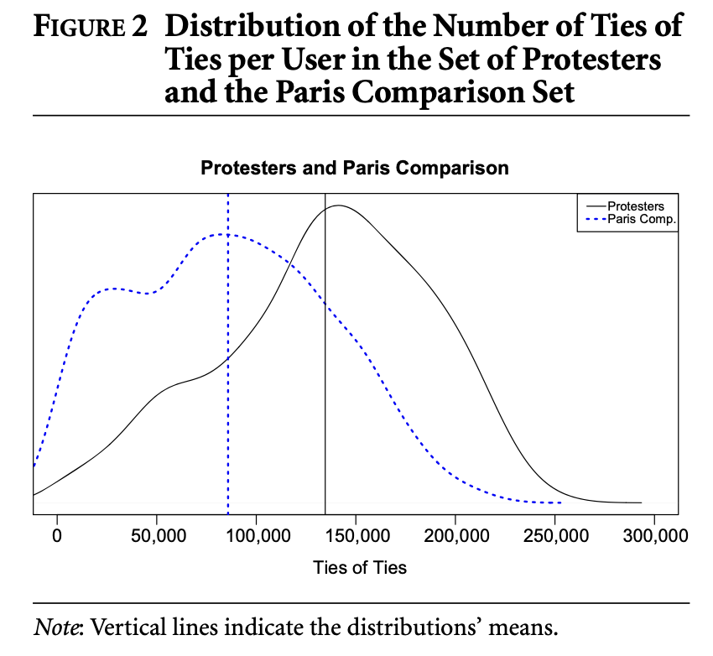
Network measures as variables

Slide 31
Network measures as variables
Network position predicts / associates with future outcomes.
IVs = Position, Brokerage, Exposure
Can be used in panel, event-history, standard regression, or other kinds of advanced methods.
Network provides added explanatory power beyond demographics or content.

Slide 32
How to use networks in SoSci research
Descriptive use
Semantic networks
Network visualization
Predictive use (network as IVs)
Centrality/brokerage/… serve as IVs in regressions
Inferential modeling (network as DV)
ERGM and its variants
Network simulation and other generative network models
Networks as embedded structures for inquiry
Network experiment

Slide 33
Network as DV to be predicted
We observed a network, then we ask:
What nodal attributes, between-node forces, and network tendencies might have existed that contributed to the observed network?

Slide 34
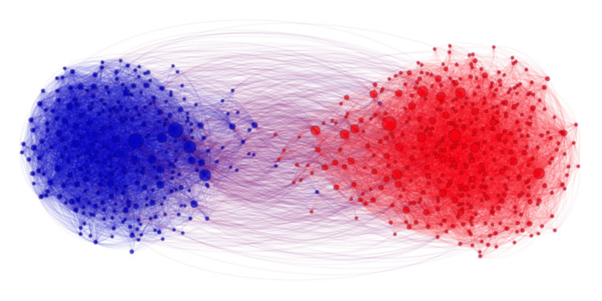
Network as DV to be predicted
We observed a network, then we ask:
What nodal attributes, between-node forces, and network tendencies might have existed that contributed to the observed network?
For example:
See this network as a DV
What predictor might have been significant in its emergence?

Slide 35
Network as DV to be predicted
We observed a network, then we ask:
What nodal attributes, between-node forces, and network tendencies might have existed that contributed to the observed network?
How can we statistically show this network comes from political polarization (Democrats and Republicans don’t connect with each other) though?

Slide 36
Network as DV to be predicted
Inferential Network Analysis:
Statistical models that treat network ties as outcomes and aim to infer the mechanisms behind observed network structure; similar to logistic regression, it predicts the probability that a pair of nodes in a network will have a tie between them, with a set of IVs
Latent Space Models – infer hidden proximity that explains ties
TERGM, SAOM (e.g., SIENA) – extend to temporal dynamics
ERGMs
ERGMs (can be applied to directed, undirected, valued, unvalued, and bipartite networks, resulting in numerous variants):
Control variables: edges (constant term, i.e., probability of tie formation overall)
Nodal attributes: organization’s industry, person’s political affiliation, etc.
Homophily tendencies: same gender, age difference, same hashtags, same party affiliation, different party affiliation, etc.
Structural parameters: reciprocity, transitivity, i.e., 2-star, 3-star, triangle, etc.
DV: 1/0 (whether or not a tie exists)

Slide 37
Network as DV to be predicted
Inferential Network Analysis
Suffer from model specification complexity similar to regressions
Which nodal covariates, dyadic covariates, and structural parameters to include
Whether to model homophily, reciprocity, transitivity, shared popularity, etc.
Like regressions, overfitting, underfitting, and omitted variable bias are risks
With TERGM/SAOM, you now also deal with temporal dynamics, which means even more decisions (e.g., memory terms, time lags)
Computationally heavy
All of these models rely on simulation-based estimation techniques like MCMC or GMM, which are slow and can be unstable
Can’t apply to enormous networks, because you are modeling N*(N-1)/2 ties
Your PC will crash with CPU/Memory problems, and in the end, you may receive a “models do not converge” warning.

Slide 38
Network as DV to be predicted
Beyond ERGMs – Other Ways to Explain Network Patterns
Simulation-based Hypothesis Testing
Examples: Permutation tests, edge rewiring, attribute shuffling
Null: What would the network look like if attributes/ties were random?
Based on the observed network, not model-driven
You keep the structure fixed, but shuffle things around
Theory-informed generative models
Examples: SBM, Degree-Corrected SBM, Barabási–Albert, Latent Space Model
Null: What structure would have emerged from these mathematical models?
Model-driven, often probabilistic
You generate networks from scratch (or from parameterized theory)
In other words: ERGMs infer; simulations and generative models ask: Could this structure have emerged from this process?

Slide 39
Network as DV to be predicted
Simulation-based Hypothesis Testing (permutation test)
Shuffle party labels to generate 100 new networks and calculate modularity each time.
How extreme is the observed modularity compared to the 100 networks?
Keep structure, randomize labels → “Is party relevant?”
Theory-informed generative models (stochastic block models)
Assign nodes to latent groups (e.g., Democrat, Republican)
Specify high within-group tie probabilities, low between-group tie probabilities
Generate 100 simulated networks under this group-based structure
Do they show similar modularity, assortativity, or community structure?
Keep labels, simulate structure → “Is group-based tie formation sufficient to (re)produce this structure?”

Slide 40
Common Generative Network Models
Category | Model | Key Idea | Characteristics | Famous Example
1. Random Graphs | Erdős–Rényi (ER) | Randomly connect node pairs | Poisson degree distribution, few hubs | Baseline for randomness
 | Configuration Model | Fix degree sequence, randomly connect stubs | Preserves degree distribution | Null model with preserved structure
2. Small-World & Clustering Models | Watts–Strogatz (WS) | Start with a ring lattice, rewire with probability | High clustering + short average path length | Human friendship networks
3. Power-Law Models | Barabási–Albert (BA) | New nodes attach to high-degree nodes | Scale-free, power-law degree, hubs | Web links, citation networks
4. Community Detection / Group-Based | Stochastic Block Model (SBM) | Partition nodes into groups; connect based on group probabilities | Captures community/cluster structure | Political blogosphere
 | Degree-Corrected SBM | Like SBM, but adjusts for degree heterogeneity | Realistic with uneven group sizes | Social affiliation networks
5. Statistical Network Models | Exponential Random Graph Models (ERGM) | Estimate tie probability based on structural features (e.g., reciprocity, triads) | Flexible and interpretable | Face-to-face friendship networks
 | Latent Space Model (LSM) | Nodes exist in a latent space; closer nodes more likely to connect | Captures proximity effects | Online dating or collaboration networks
6. Dynamic/Temporal Models | Actor-Oriented Models (SIENA) | Model evolution of ties based on actor-level decisions | Micro-level changes over time | Teen friendship evolution
 | Relational Event Models (REM) | Model sequences of interaction events | Time-stamped dyadic data | Email, chat logs

Slide 41
How to use networks in SoSci research
Descriptive use
Semantic networks
Network visualization
Predictive use (network as IVs)
Centrality/brokerage/… serve as IVs in regressions
Inferential modeling (network as DV)
ERGM and its variants
Network simulation and other generative network models
Networks as embedded structures for inquiry
Network experiment

Slide 42
Networks as Basic Structure for Inquiries
Not just analyzing the network, we are using it as infrastructure
We define networks and determine who interacts with whom, when, and how often, and ask how structure affects outcomes
Examples:
Network experiment: Manipulate network structure (e.g., add influencers, remove ties).
Control: No Influencer; Treatment: With an influencer who communicates more
Control: Observed communication network; Treatment: All long-range tie removed
Message experiment within a network: Deliver different messages to central vs peripheral nodes.
Same network, deliver message to different nodes to start with
Etc.

Slide 43
Networks as Basic Structure for Inquiries
Centola (2010, Science): Built artificial online health networks
Randomly assigned participants to:
Clustered-lattice networks vs random networks
Tracked how health behavior (e.g., signing up for an exercise program) spread
Found: Clustered networks led to more stable behavioral adoption than random ones.
Takeaway: Even with the same messages and people, the network structure changed the outcome.

Slide 44
Networks as Basic Structure for Inquiries
We can also think of a field experiment design that uses existing/observed networks
Field experiment on Twitter: Inject political messages into different types of nodes:
High-degree (popular) vs low-degree users
Echo chambers vs bridge nodes
Outcome: Which messages travel farther? Which reach across party lines?
Lesson: Network position + content jointly affect political diffusion and polarization.

Slide 45
How to use networks in SoSci research
Descriptive use
Semantic networks
Network visualization
Predictive use (network as IVs)
Centrality/brokerage/… serve as IVs in regressions
Inferential modeling (network as DV)
ERGM and its variants
Network simulation and other generative network models
Networks as embedded structures for inquiry
Network experiment

Slide 46
Words of Caution

Slide 47
Caution – Interpretation
Metrics are constructed and must be interpreted in context, for example, which centrality measure captures “influencer”?
Central ≠ Important: A node with high degree might be popular, but not influential in diffusion
Unit of analysis matters: Actor-level stats must align with research questions
Complementary metrics: Use multiple indicators to triangulate
Ask if a measure is substantively meaningful

Slide 48
Caution – Network for Network’s Sake
Some papers try to use network analysis to fluff up papers methodologically, but in fact, there is no need for network at all
E.g., a network of text messages between people
Nodes as persons; weighted ties as messages
The indegree of a (person) node is basically the number of messages they receive. Do you need a network for that?
E.g., seductive hairball visualization while analytically empty
Use networks only when…
Your theory is relational, or
You’re interested in structure (e.g., brokerage, redundancy), or
You’re modeling processes (e.g., diffusion, competition, influence)
Use networks only when you are studying networked phenomena

Slide 49
Network - Rarely Used in Isolation
Network structure reveals who is connected to whom, but not why, how, or what it means.
Other methods complement network analysis:
Text Analysis / NLP: for uncovering meaning or themes behind the nodes/edges.
Statistical Modeling: to predict influence, centrality, diffusion.
Visualization: for pattern recognition and communicative clarity.
Temporal Models: to understand how networks evolve over time.
In excellent CSS studies, network analysis is rarely used in isolation --- it usually comes with a strategic combination of other novel CSS methods.

Slide 50
Presentation: Zhao et al. (2022)

Slide 51
Presentation: Zhao et al. (2022)
Understand the social network and influence of ancient Chinese poets.
Combined methods:
Text mining + Named Entity Recognition: Identify poets and their references to one another.
Network Analysis: Build directed influence networks among poets.
Network Simulation: Susceptible–Infected (SI) Model
Temporal Slicing: Examine changing influence across historical periods.
Centrality Measures + Topic Modeling: Identify influential poets and thematic shifts.

Slide 52
Lab Preview
Short Lecture <What Networks Could Be>
Semantic network of <presidential_speeches.csv>
Visualization of semantic networks in R and Gephi
ERGM for social networks
YouTube API
Go to https://developers.google.com/youtube/v3/getting-started
Apply for the API
We will use it in the next lab
Tomorrow’s Presentation
Jikai Sun
Jong Won Lee
Shreepriya Dogra

Slide 53
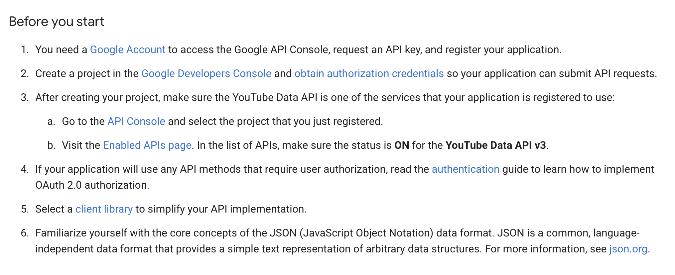
Finish the first 3 steps first

Slide 54
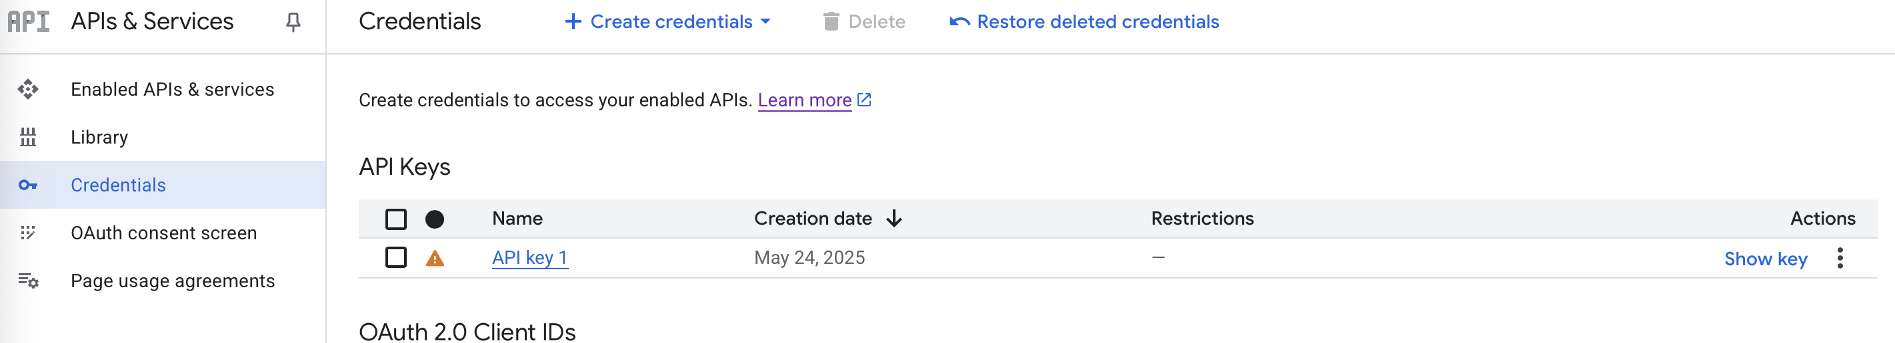
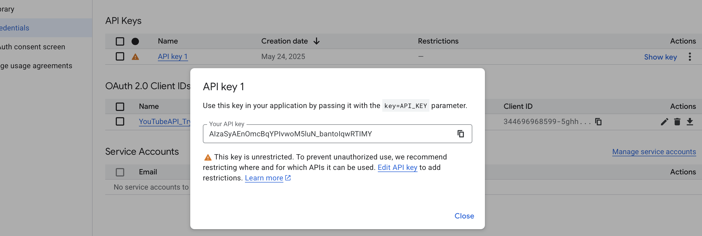
To get ready for Day 5, you need to
Go to https://console.cloud.google.com/apis/credentials
To see that, under “API Keys” there is a API key for you
And you can click “show key” to see your key

